Slide 1
Testautomation
23/4: KUL - campus Geel

Slide 2

Bio
Stef Daems
Consultant @ Devoteam
10 years of experience in test automation
Proximus, KPN, Telenet, LGI
Tech-lead Automation and Tooling @ Liberty Global International - EOS project

Slide 3
Planning
Project EOS
Why test automation is important
XAGGET eco-system
Manage and distribution XAGGET
HZNGO testing

Slide 4

Project EOS

Slide 5
Project EOS
Liberty Global indirectly owns 57.5% of Telenet, as of September 30, 2016.

Slide 6
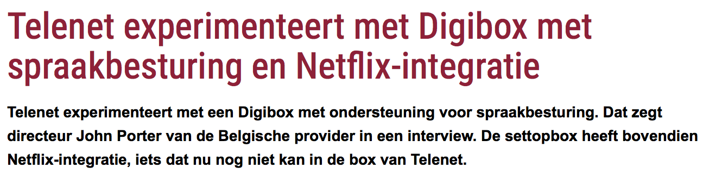
Project EOS
Belgian TV quality standards
Telenet driver seat
Main office Herentals
Labo Mechelen

Slide 7
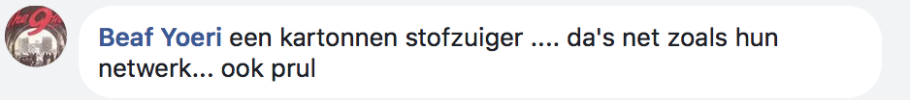
Project EOS
Complexity
picture network

Slide 8
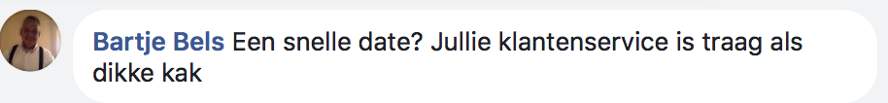
Project EOS
High speed
Cadence image

Slide 9
Project EOS

Slide 10
Importance TA
Agile = quick delivery
Multiple platforms
Complexity
Objectiveness
We’re human

Slide 11
Importance TA

Slide 12
Importance TA

